Slide 1


MICROSOFT COPILOT STUDIO & AI AUTOMATION BOOTCAMP

Slide 2
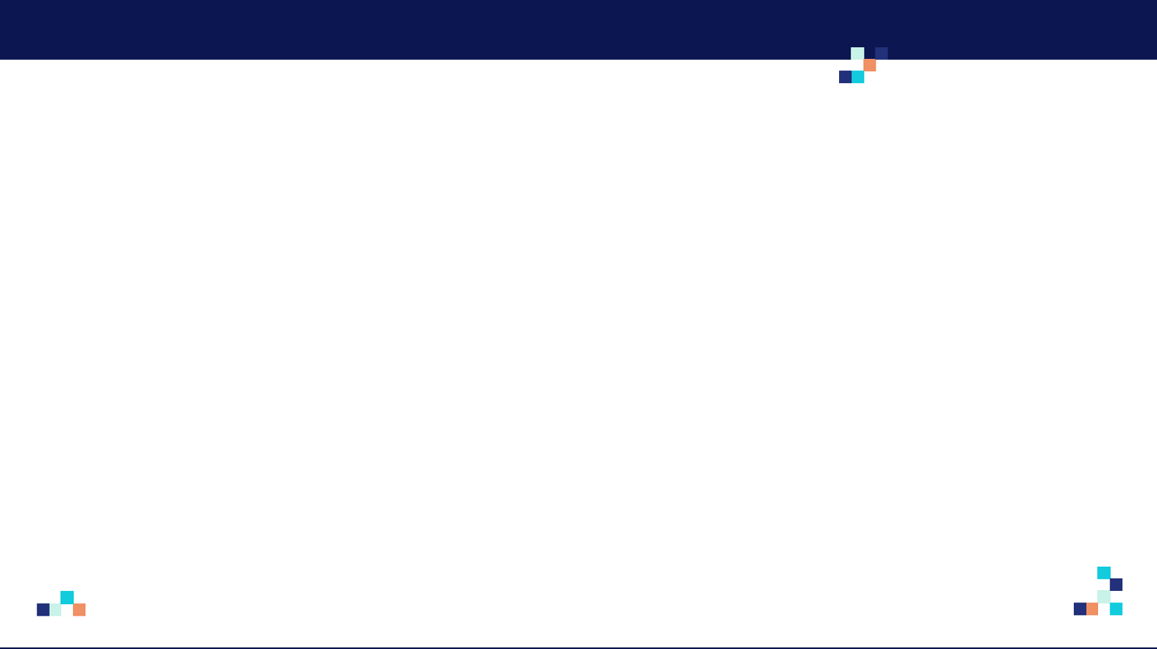


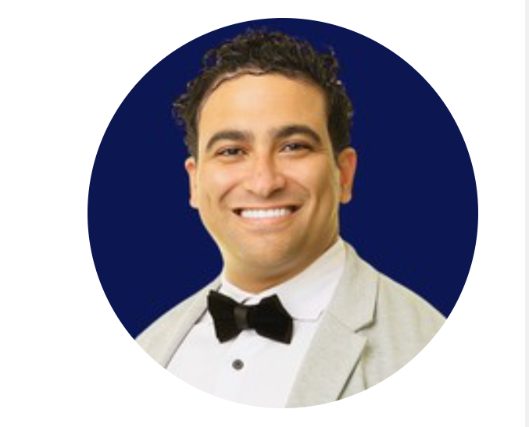
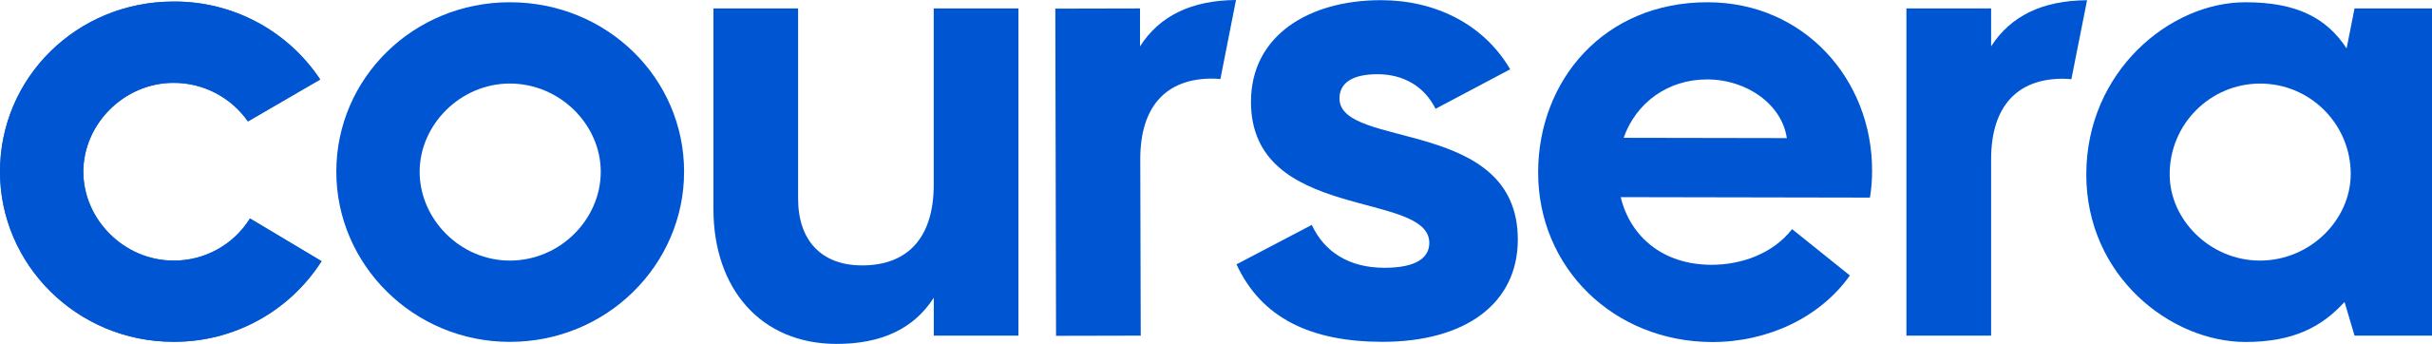




Instructor Introduction
500,000+ Students
M.A.Sc., Ph.D., MBA
258,000+ Subs, 3.5M views
        Dr. Ryan Ahmed
        Professor & Best-selling Instructor
© All rights reserved for Dr. Ryan Ahmed @Stemplicity Inc.
AI & EV/AV
Taught L1 & 2 Python & AI

Slide 3
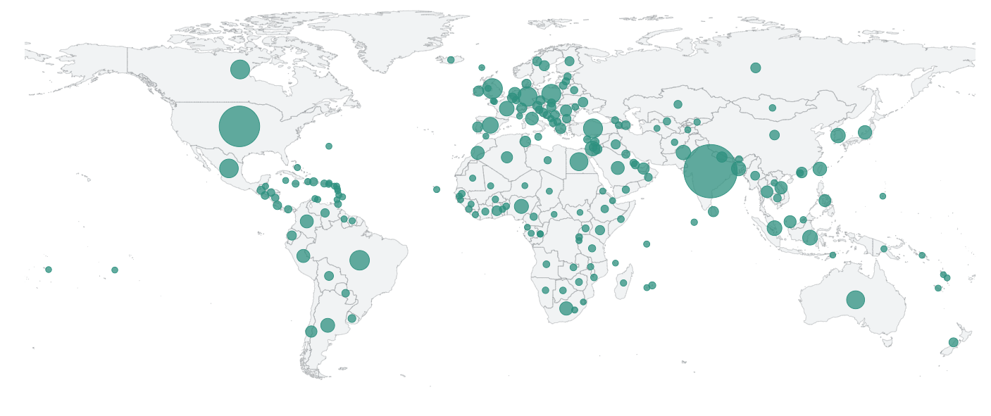











Global Students Reach
© All rights reserved for Dr. Ryan Ahmed @Stemplicity Inc.

Slide 4
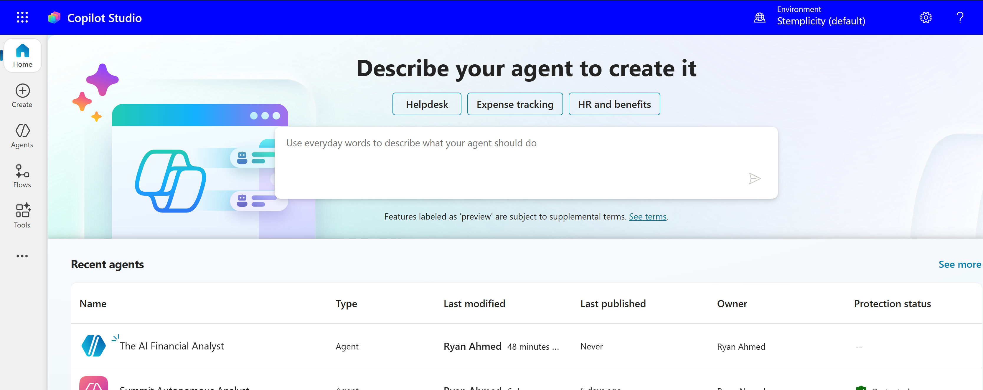
CoPilot Studio Demo
🔗 Click here to explore CoPilot
CoPilot Studio Signup
© All rights reserved for Dr. Ryan Ahmed @Stemplicity Inc.

Slide 5
BOOTCAMP OUTLINE & KEY SUCCESS TIPS

Slide 6
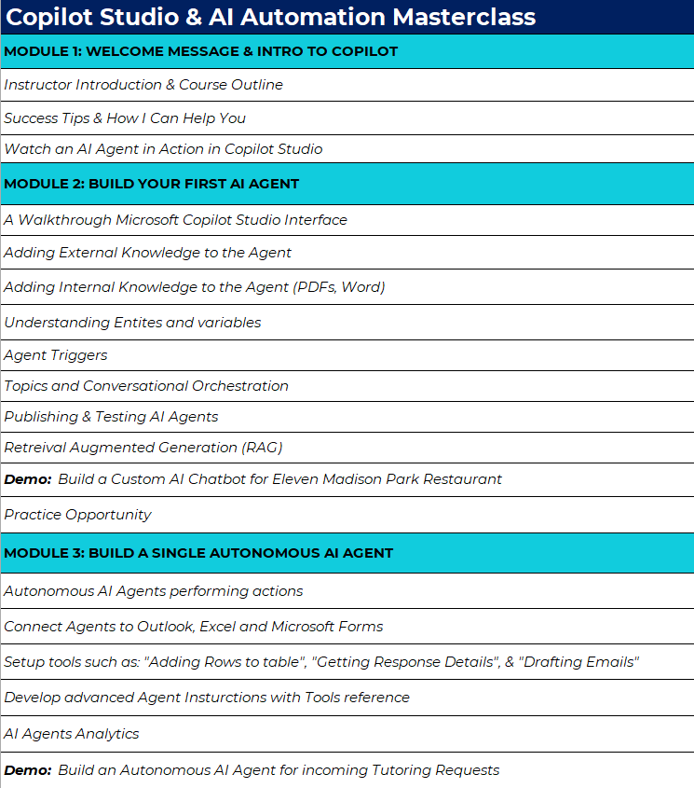
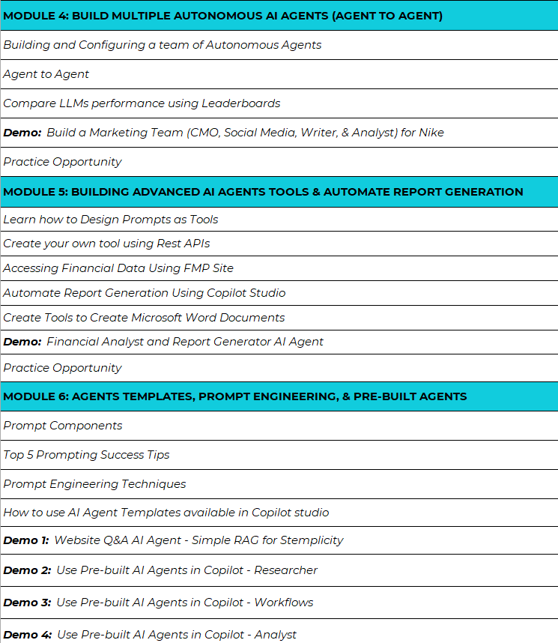
Bootcamp Outline
Check the course outline here:
© All rights reserved for Dr. Ryan Ahmed @Stemplicity Inc.

Slide 7
Success Tips
Learn by Doing!
Build a Portfolio of Projects
Solve Practice Opportunities
Leverage LinkedIn to share your work & maximize Reach!
© All rights reserved for Dr. Ryan Ahmed @Stemplicity Inc.
LinkedIn Link: https://www.linkedin.com/in/dr-ryan-ahmed/

Slide 8
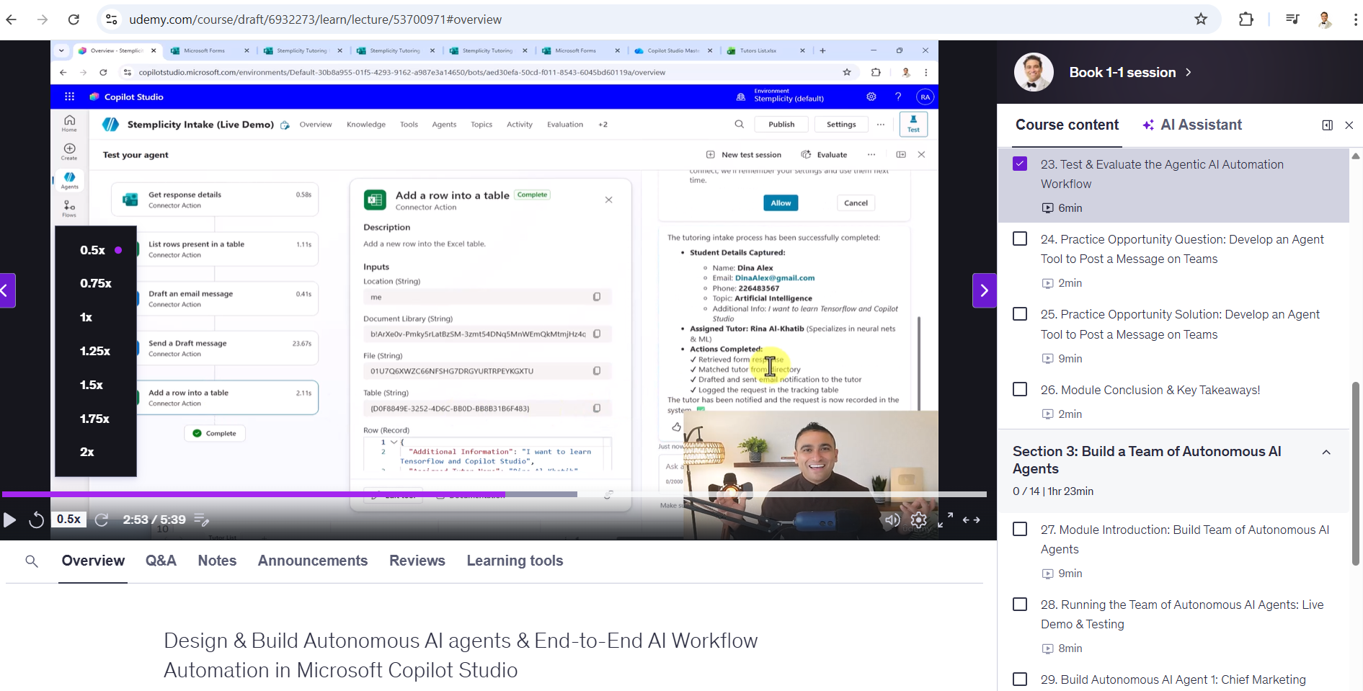
Change video Speeds
You have the option to play lectures at different speeds: (.5x, 1x, 1.25x, 1.5x or 2x)
In the bottom-left corner of the video, you can change the speed of the video.
© All rights reserved for Dr. Ryan Ahmed @Stemplicity Inc.

Slide 9
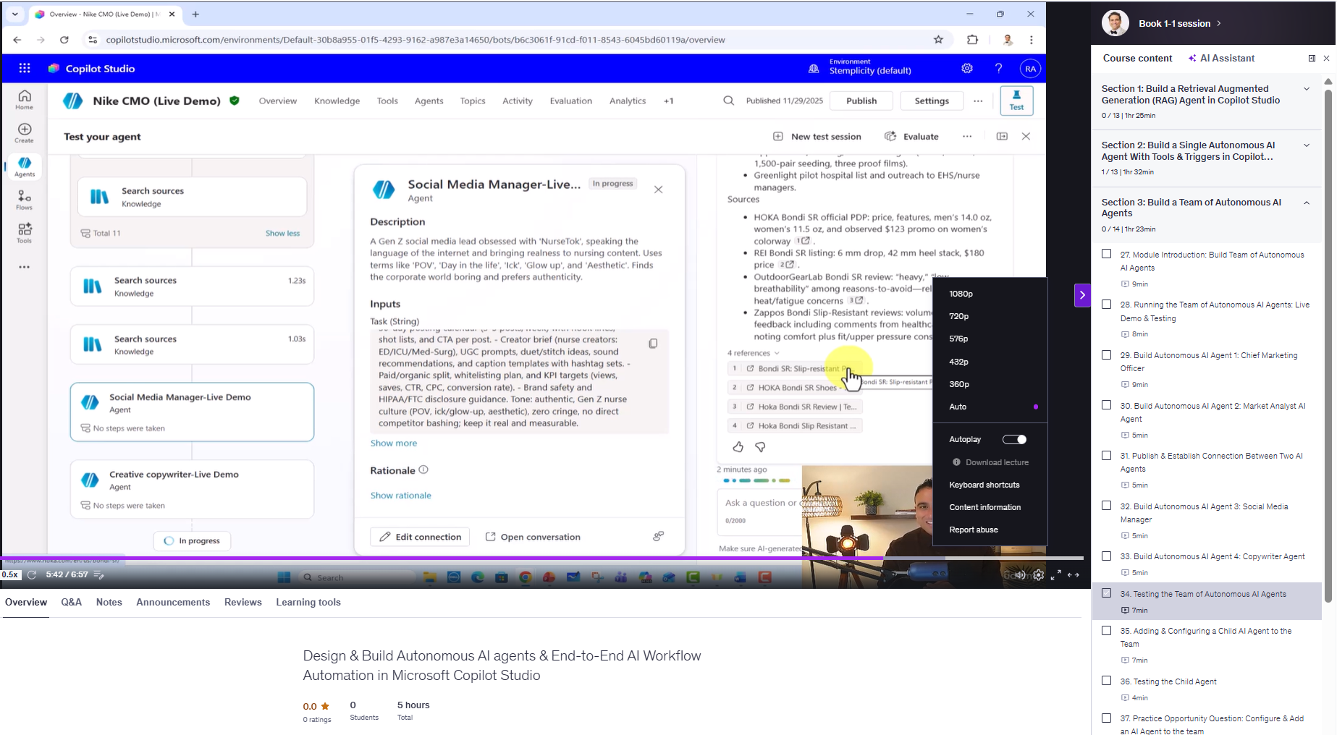
Change the video quality
Udemy automatically optimizes video resolution based on your internet connection speed. Alternatively, you can select 360p, 480p, and 720p resolutions for the video quality.
All course lectures are filmed with HD quality 1080p.
© All rights reserved for Dr. Ryan Ahmed @Stemplicity Inc.

Slide 10
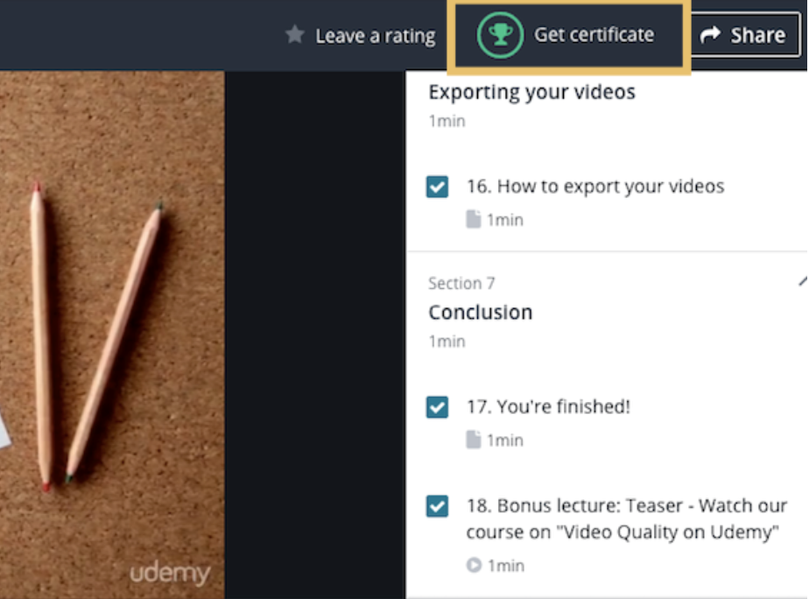
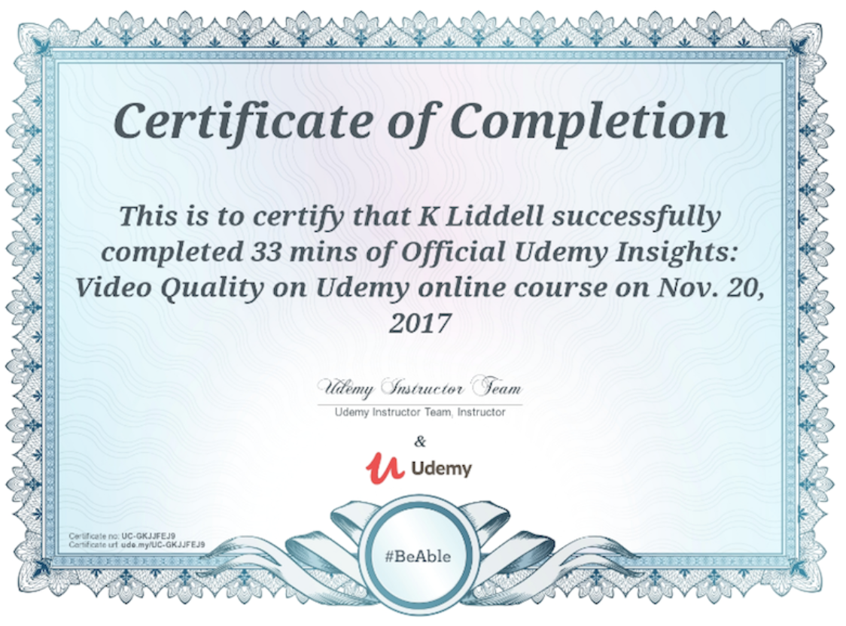
How do you get the Certificate of Completion?
When you complete all course modules, you will receive a certificate of completion.
© All rights reserved for Dr. Ryan Ahmed @Stemplicity Inc.

Slide 11
Thank you!

